Slide 1
Fig. S1 Diagrammatic sketch of 4 clipped samples from each individual kelp.
Fig. S2 Ontology enrichment analysis of novel genes.
Fig. S3 Overview of expression profiles of genes with developmental stages (a) and along the frond (b).
Fig. S4 Contents of mannitol and alginate in S. japonica detected in different developmental stages and tissues from January to June.
Fig. S5 Hierarchical cluster tree showing 22 modules of co-expressed genes.
Fig. S6 Gene expression pattern in modules of “darkorange” (a), “mediumpurple” (b) and “greenyellow” (c).
Fig. S7 Saccharina cultivation mode with rhizoid attached to cultivation rope and blade inversely grown from sea surface to undersea.

Slide 2
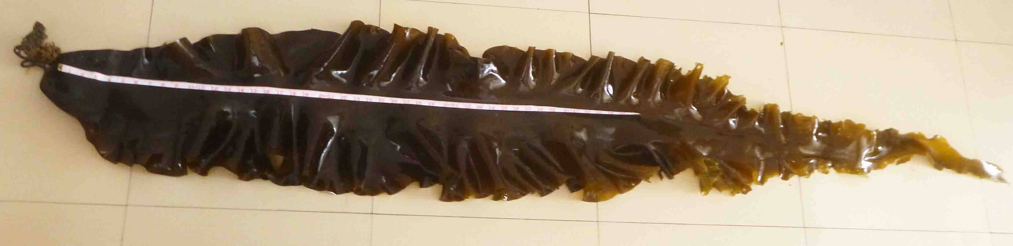
Fig. S1
Basal blade
1/3 blade
2/3 blade
distal blade

Slide 3
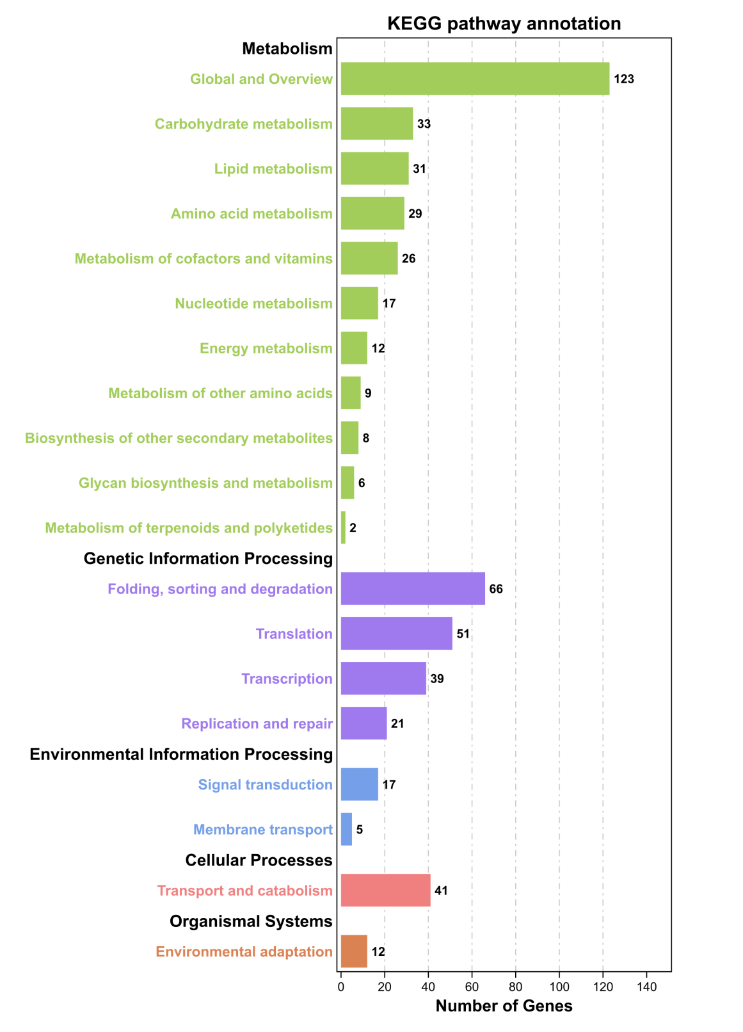
Fig. S2

Slide 4
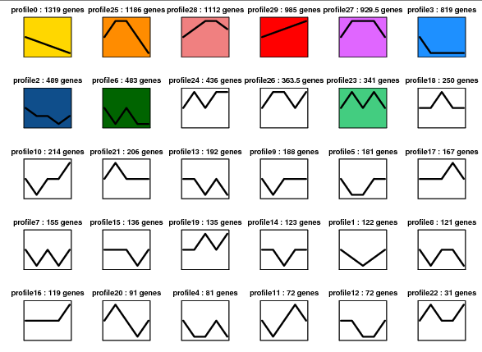
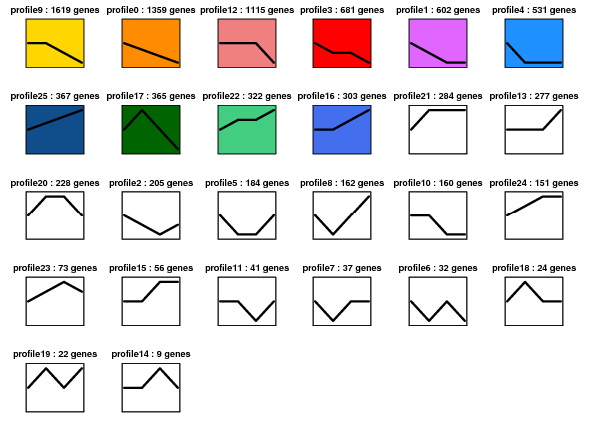
a
Fig. S3
b

Slide 5
a
Fig. S4
Alginate (%)
b
Mannitol (%)

Slide 6
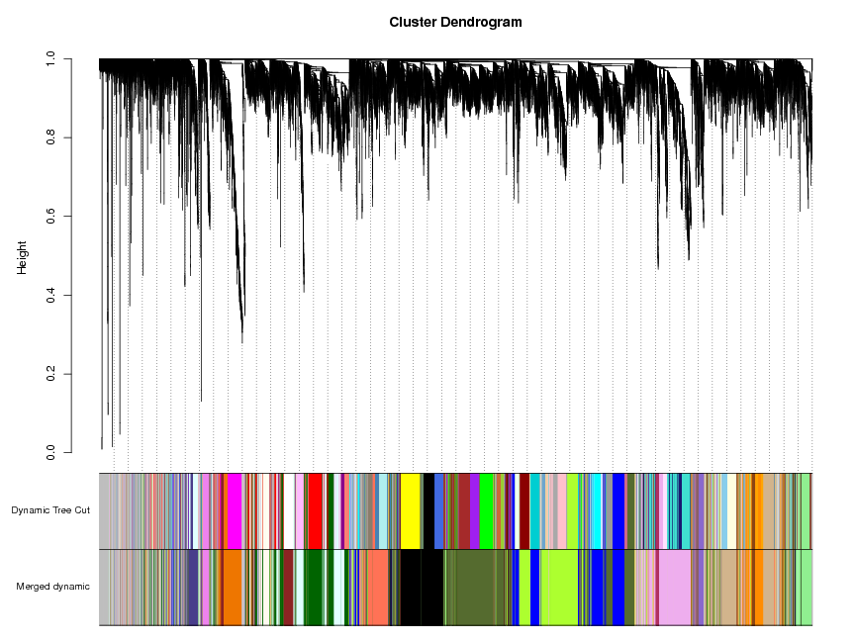
Fig. S5

Slide 7
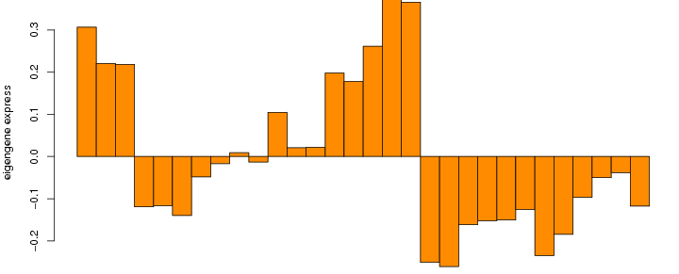
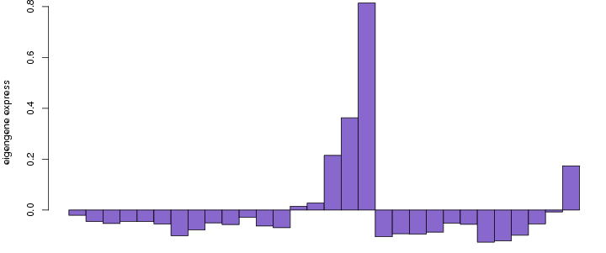
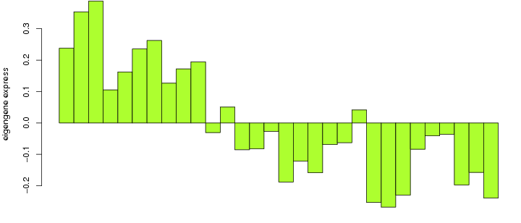
Fig. S6
a
Darkorange
b
Mediumpurple
c
Greenyellow

Slide 8


Fig. S7
buoy
rope
kelp
base
Kelp developments
tip

